Slide 1





Empirical Evaluation
1
Meaningful Patterns
2
Comparison with syntax-based approach
3
Activities
4
Commonality of Patterns
5
Temporal Distribution

Slide 2
Data Collection
 | Survey Corpus | Depth Corpus
Projects | 5,832 | 88
Total source files | 35M | 1M
Total SLOCs at last snapshots | 4.1B | 164M
Developers with analyzed commits | 171K | 13K
Java code change commits | 292K | 88K
Total changed files | 592K | 291K
Total SLOCs of changed files | 216M | 81M
Total changed methods (graphs) | 824K | 322K
Total AST nodes of changed methods | 92M | 34M
Total changed graph nodes | 8M | 3M

Slide 3
Meaningful Patterns (RQ1)
Surveying Real Developers
Q1: Is the change at these lines similar to another change in the past?
Q2: Can you briefly describe the change and why you made it?
Q3: Can you give a name for the change?
Q4: Would you like to have this change automated by a tool?
Dataset of 5,832 long-history, fresh and highly rated projects

Slide 4
Survey Results
Q1 Is the highlighted change at these lines similar to another in the past?
Yes | No | Not sure |  | No answer
69% | 22% | 6% |  | 3%
Q3 Can you give it a name?
Yes | No |  |  | No answer
79% | 18% |  |  | 3%
Q4 Would you like to have this change automated by a tool?
Yes | No | Not sure | Already Automated | No answer
44% | 34% | 9% | 10% | 3%

Slide 5
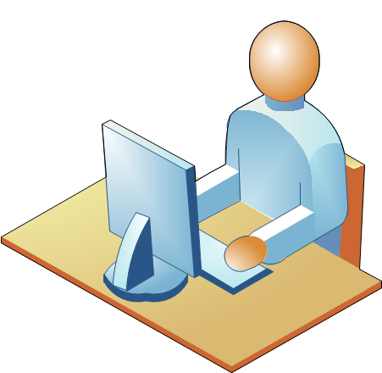
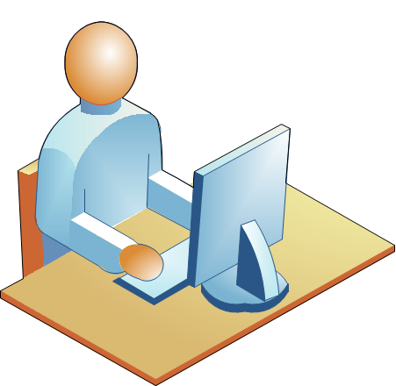
Examples for Q4
No, the tool would need to be able to make decisions based on the end use of the API which I would assume is not possible... (I might be wrong :))
I think it is very challenging which makes your research promising!
D15
D108

Slide 6
Examples
“I would definitely love a tool that checks my code
and propose me advanced refactoring”
Before
After
1 String id = Jobjet_event.getString("id");
2 if ( ! this . eventDao.isExisting(id) ) {_________
3
4 ….
5
6 this . eventDao.add(event); _____________
7 }
1 String id = Jobjet_event.getString("id”);
2 if ( this . eventDao.isExisting(id) ) {__________
3+ this . eventDao.add(event); ________
4+ } else {________________________________
5 ….
6 this . eventDao.add(event); _____________
7 }
“Adding a Condition Branch” Change Pattern in Project ApplETS
Notes:
https://nguyenhoan.github.io/CPatMiner for more examples

Slide 7
Diversity of Change Patterns (RQ3)
10% participants stated that the detected change patterns
have already been automated by IDEs

Slide 8
Comparative Study (RQ2)
Compare with the approach (BASE) using the syntax-based representation of changes
Run BASE on the same survey corpus
Randomly select pairs of changes
Human judgement

Slide 9
Comparative Results
CPatMiner detects 2.1x more
meaningful patterns than BASE
 | CPatMiner | BASE | Draw | Undecided
#Cases | 50 | 3 | 30 | 17
Percentage | 50% | 3% | 30% | 17%
Notes:
65% of the cases that BASE incorrectly detected as patterns
59% of the cases, BASE groups the atomic syntactic changes that have no relation

Slide 10
Comparative Results
 | CPatMiner | BASE | Draw | Undecided
#Cases | 50
Percentage

Slide 11
Example
Before
After
1 boolean isIdentifierIfAlreadyExisting (...) throws SQLException {
2
3 …
7 ResultSet rs = statement.executeQuery();
8 …
12 – statement.close() ; _________________________________
1 boolean isIdentifierIfAlreadyExisting (...) throws SQLException {
2
3+ try { ___________________________________________
7 ResultSet rs = statement.executeQuery(); ________
12+ } finally { closeQuietly (statement); } __________________
“Closing resources” Change Pattern in Project anHALytics
Notes:
BASE cannot relate the addition of closeQuietly(statement) on line 12 with the statement statement.executeQuery() on line 7
to form a meaningful pattern of closing resources used with executeQuery().

Slide 12
Commonality and Temporal Distribution
 | Depth Corpus
Projects | 88
Total source files | 1M
Total SLOCs at last snapshots | 164M
Developers with analyzed commits | 13K
Java code change commits | 88K
Total changed files | 291K
Total SLOCs of changed files | 81M
Total changed methods (graphs) | 322K
Total AST nodes of changed methods | 34M
Total changed graph nodes | 3M
Notes:
We aimed to study commonality and temporal distribution of change patterns.
We posit that the change patterns performed on different projects and by different programmers have different degrees of commonality and temporal distribution.

Slide 13
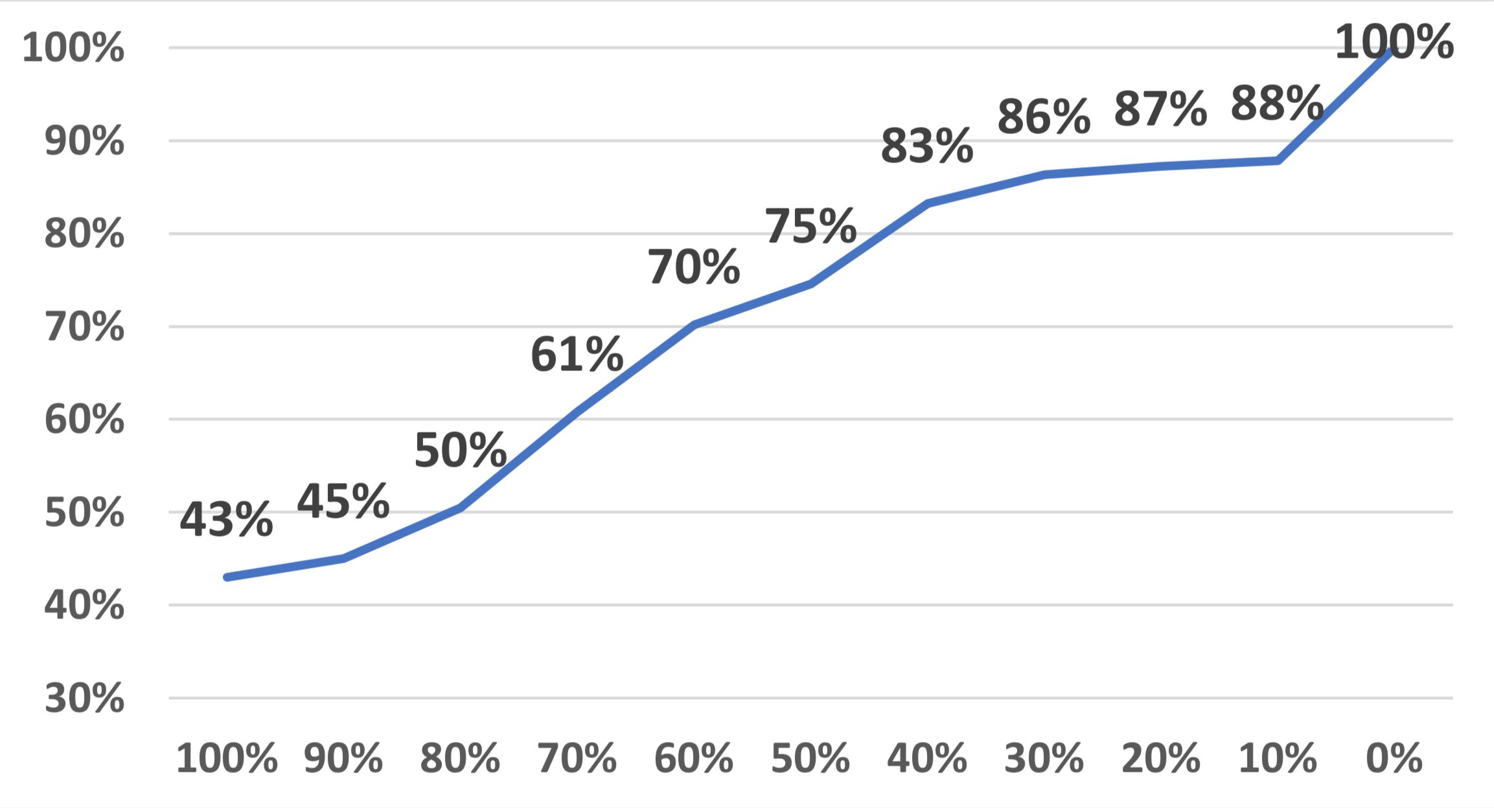
Commonality of Patterns (RQ4)
Over developers

Slide 14
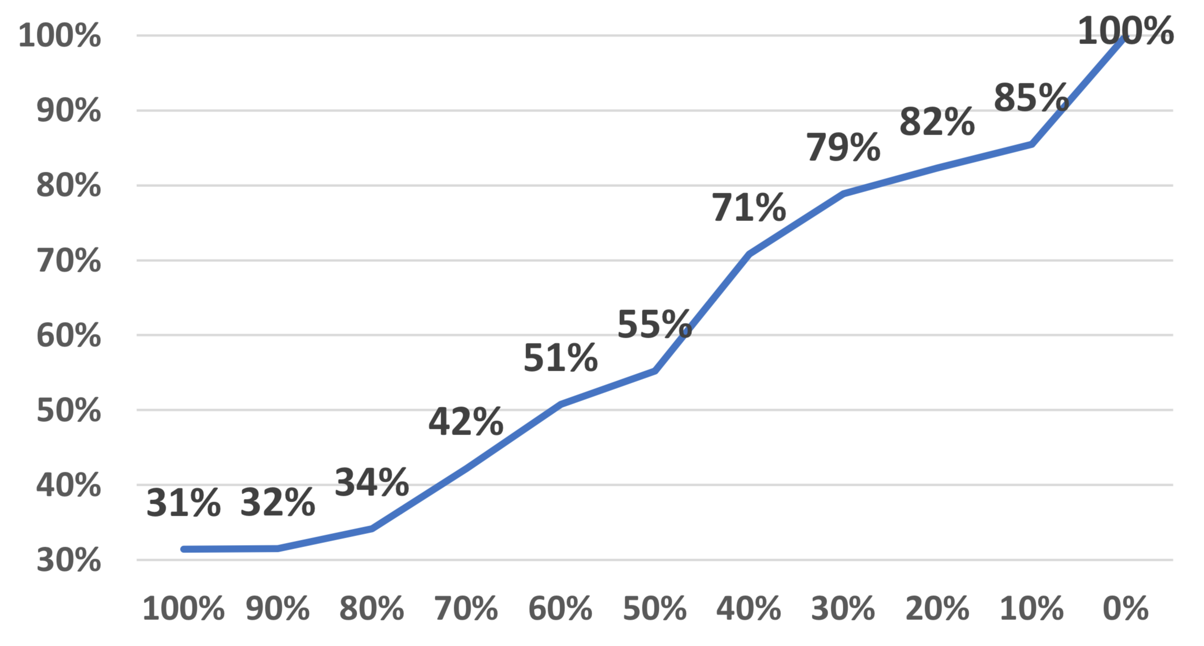
Commonality of Patterns (RQ4)
Fine-grained change patterns are pervasive
among developers and teams
Over developers
Over projects
Notes:
Same trend

Slide 15
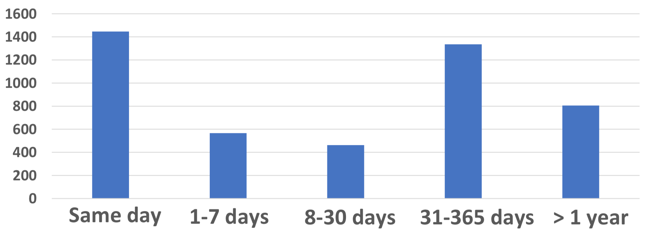
Temporal Distribution of Patterns (RQ5)

